Slide 1


INNOMATICS TECHNOLOGY HUB
A sister concern of

Slide 2
Basic Statistical Terminology

Slide 3
Statistics – Big Picture
Statistics provides a way of organizing data to extract information on a wider and objective basis than relying on personal experience
Data Gathering
Data Understanding
Data Analysis/Interpretation
Data Presentation

Slide 4
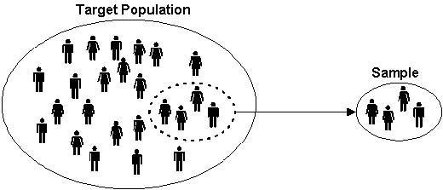
Population and Sample
Source: http://www.snapsurveys.com/blog/wp-content/uploads/2011/08/target-population.jpg
Last accessed: October 7, 2014

Slide 5
Census and Survey
Census: Gathering data from the whole population of interest.
For example, elections, 10-year census, etc.
Survey: Gathering data from the sample in order to make conclusions about the population.
For example, opinion polls, quality control checks in manufacturing units, etc.

Slide 6
Statistics is “A telescope that allows us to study the large terrain and make it accessible to our unaided vision”

Slide 7
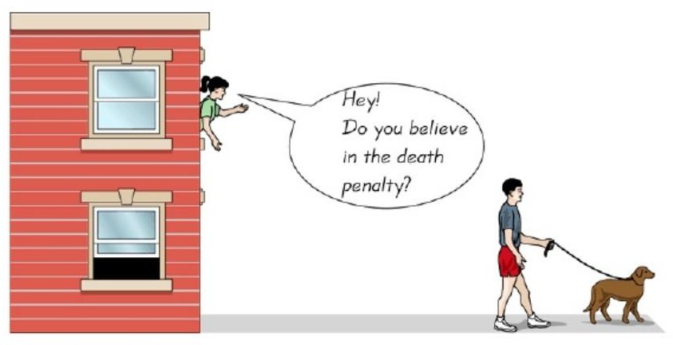
Data Gathering – Sampling Techniques
Convenience Sampling
Eg: Online polls, Asking your best friends etc

Slide 8
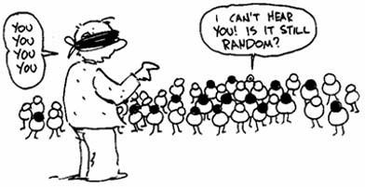
Data Gathering – Sampling Techniques
Random Sampling
Each member has an equal chance of being selected.

Slide 9
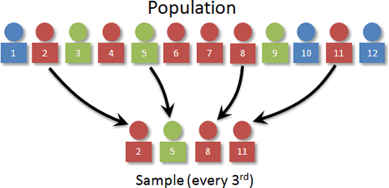
Sampling Techniques
Systematic Random Sampling
Example: Supermarket chooses every 10th or 15th customer entering the supermarket and conduct the survey.

Slide 10
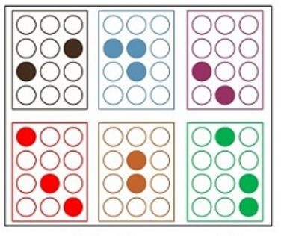
Sampling Techniques
Stratified Sampling
– Divide the data into several relevant strata and then sample from each strata
Eg: For getting an opinion on demonetization, one choice of strata might be state-wise analysis. We get 20 random volunteers from each and every state.

Slide 11
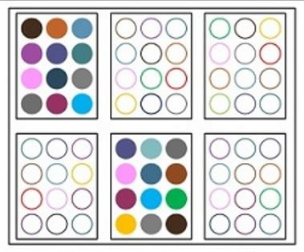
Sampling Techniques
Cluster Sampling
–Divide the population in to groups or clusters. Then select a one or a few clusters and survey everyone from the chosen subset.

Slide 12
Parameter and Statistic
Parameter: A descriptive measure of the population. For example, population mean, population variance, population standard deviation, etc.
Statistic: A descriptive measure of the sample. For example, sample mean, sample variance, sample standard deviation, etc.

Slide 13
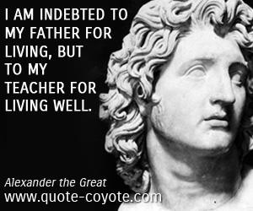
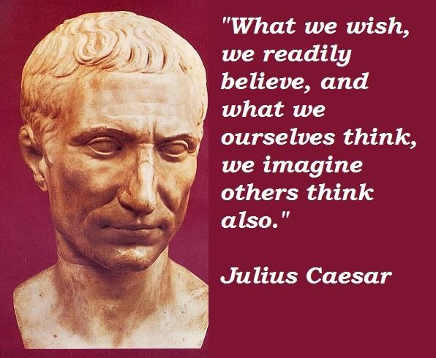
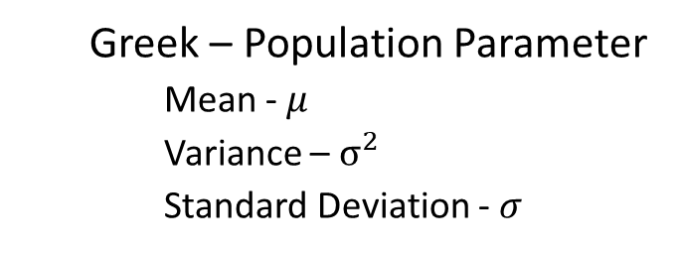
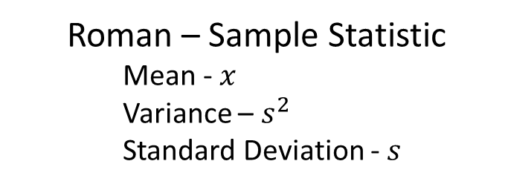
Parameter and Statistics
Greek – Population Parameter
Mean - $μ$
Variance – $σ^{2}$
Standard Deviation - $σ$
Roman – Sample Statistic
Mean - $x$
Variance – $s^{2}$
Standard Deviation - $s$

Slide 14
Statistics
Descriptive Statistics
♣ Data gathered about a group to reach conclusion about the same group.
Inferential Statistics
♣ Data gathered from a sample and the statistics generated to reach conclusion about the population from which the sample is taken. Also known as Inductive Statistics

Slide 15
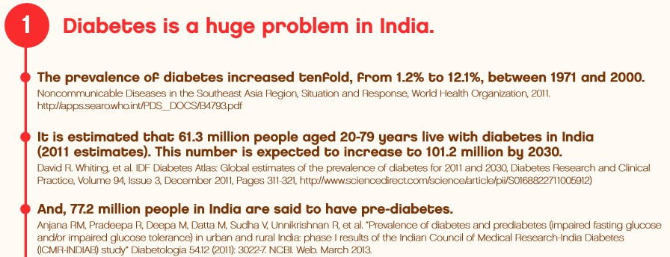
Descriptive and Inferential Statistics
Source: http://www.arogyaworld.org/wp- content/uploads/2010/10/Arogya World_IndiaDiabetes_FactSheets_ CGI2013_web.pdf
Last accessed: November 25, 2015

Slide 16
Variables and Data
model | mpg | cyl | disp | hp | drat | wt | qsec | vs | am | gear | carb
Mazda RX4 | 21 | 6 | 160 | 110 | 3.9 | 2.62 | 16.46 | 0 | 1 | 4 | 4
Mazda RX4 Wag | 21 | 6 | 160 | 110 | 3.9 | 2.875 | 17.02 | 0 | 1 | 4 | 4
Datsun 710 | 22.8 | 4 | 108 | 93 | 3.85 | 2.32 | 18.61 | 1 | 1 | 4 | 1
Hornet 4 Drive | 21.4 | 6 | 258 | 110 | 3.08 | 3.215 | 19.44 | 1 | 0 | 3 | 1
Hornet Sportabout | 18.7 | 8 | 360 | 175 | 3.15 | 3.44 | 17.02 | 0 | 0 | 3 | 2
Valiant | 18.1 | 6 | 225 | 105 | 2.76 | 3.46 | 20.22 | 1 | 0 | 3 | 1
Duster 360 | 14.3 | 8 | 360 | 245 | 3.21 | 3.57 | 15.84 | 0 | 0 | 3 | 4
Merc 240D | 24.4 | 4 | 146.7 | 62 | 3.69 | 3.19 | 20 | 1 | 0 | 4 | 2
Merc 230 | 22.8 | 4 | 140.8 | 95 | 3.92 | 3.15 | 22.9 | 1 | 0 | 4 | 2
Merc 280 | 19.2 | 6 | 167.6 | 123 | 3.92 | 3.44 | 18.3 | 1 | 0 | 4 | 4
Merc 280C | 17.8 | 6 | 167.6 | 123 | 3.92 | 3.44 | 18.9 | 1 | 0 | 4 | 4
Merc 450SE | 16.4 | 8 | 275.8 | 180 | 3.07 | 4.07 | 17.4 | 0 | 0 | 3 | 3
Merc 450SL | 17.3 | 8 | 275.8 | 180 | 3.07 | 3.73 | 17.6 | 0 | 0 | 3 | 3
Merc 450SLC | 15.2 | 8 | 275.8 | 180 | 3.07 | 3.78 | 18 | 0 | 0 | 3 | 3
Cadillac Fleetwood | 10.4 | 8 | 472 | 205 | 2.93 | 5.25 | 17.98 | 0 | 0 | 3 | 4
Lincoln Continental | 10.4 | 8 | 460 | 215 | 3 | 5.424 | 17.82 | 0 | 0 | 3 | 4
Chrysler Imperial | 14.7 | 8 | 440 | 230 | 3.23 | 5.345 | 17.42 | 0 | 0 | 3 | 4
Fiat 128 | 32.4 | 4 | 78.7 | 66 | 4.08 | 2.2 | 19.47 | 1 | 1 | 4 | 1
Honda Civic | 30.4 | 4 | 75.7 | 52 | 4.93 | 1.615 | 18.52 | 1 | 1 | 4 | 2
Toyota Corolla | 33.9 | 4 | 71.1 | 65 | 4.22 | 1.835 | 19.9 | 1 | 1 | 4 | 1
Toyota Corona | 21.5 | 4 | 120.1 | 97 | 3.7 | 2.465 | 20.01 | 1 | 0 | 3 | 1
Dodge Challenger | 15.5 | 8 | 318 | 150 | 2.76 | 3.52 | 16.87 | 0 | 0 | 3 | 2
AMC Javelin | 15.2 | 8 | 304 | 150 | 3.15 | 3.435 | 17.3 | 0 | 0 | 3 | 2
Camaro Z28 | 13.3 | 8 | 350 | 245 | 3.73 | 3.84 | 15.41 | 0 | 0 | 3 | 4
Pontiac Firebird | 19.2 | 8 | 400 | 175 | 3.08 | 3.845 | 17.05 | 0 | 0 | 3 | 2
Fiat X1-9 | 27.3 | 4 | 79 | 66 | 4.08 | 1.935 | 18.9 | 1 | 1 | 4 | 1
Porsche 914-2 | 26 | 4 | 120.3 | 91 | 4.43 | 2.14 | 16.7 | 0 | 1 | 5 | 2
Lotus Europa | 30.4 | 4 | 95.1 | 113 | 3.77 | 1.513 | 16.9 | 1 | 1 | 5 | 2
Ford Pantera L | 15.8 | 8 | 351 | 264 | 4.22 | 3.17 | 14.5 | 0 | 1 | 5 | 4
Ferrari Dino | 19.7 | 6 | 145 | 175 | 3.62 | 2.77 | 15.5 | 0 | 1 | 5 | 6
Maserati Bora | 15 | 8 | 301 | 335 | 3.54 | 3.57 | 14.6 | 0 | 1 | 5 | 8
Volvo 142E | 21.4 | 4 | 121 | 109 | 4.11 | 2.78 | 18.6 | 1 | 1 | 4 | 2

Slide 17
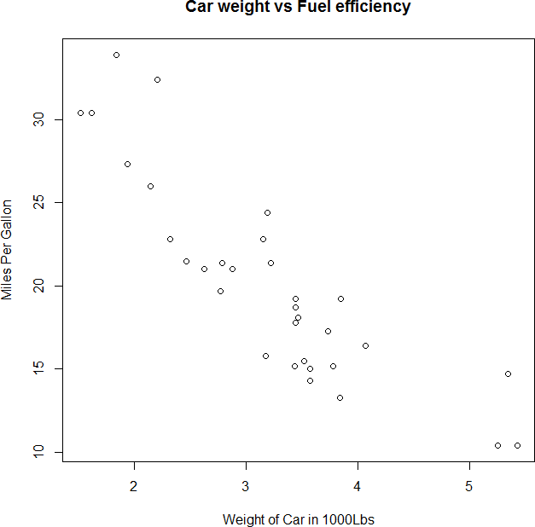
Variables – Dependent and Independent
Dependent variables on y-axis and Independent on x-axis.
Dependent variable also called Target variable or Class variable.

Slide 18
Data
Qualitative data (Categorical)
♣ is descriptive information (it describes something)
Quantitative data
(Numerical)
♣ is numerical information (number)
Discrete
Continuous

Slide 19
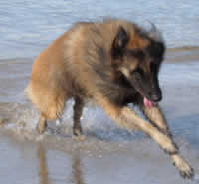
What do we know about Arrow the Dog?
Qualitative:
He is brown and black
He has long hair
He has lots of energy
Quantitative:
Discrete:
He has 4 legs
He has 2 brothers
Continuous:
He weighs 25.5 kg
He is 565 mm tall

Slide 20
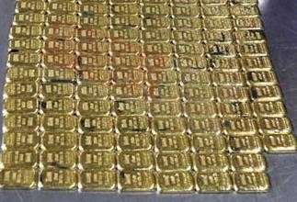
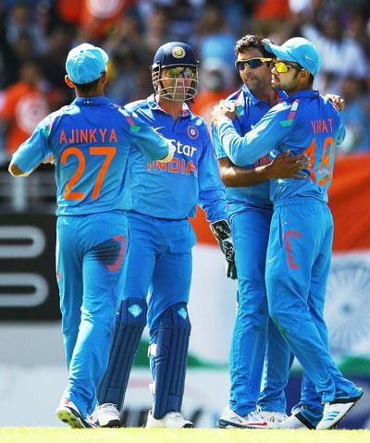

Data – Numeric and Categorical
18
7

Slide 21
Data
Categorical
Numerical
Nominal
Ordinal
Interval
Ratio

Slide 22
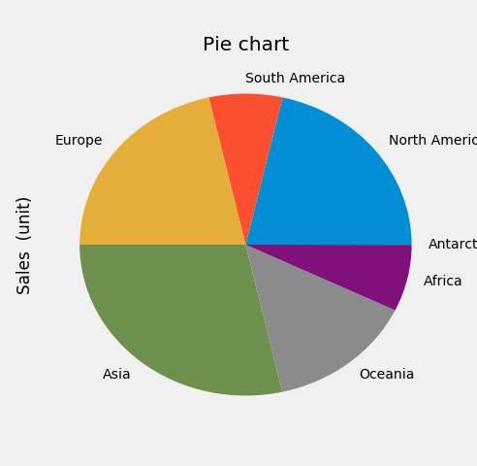
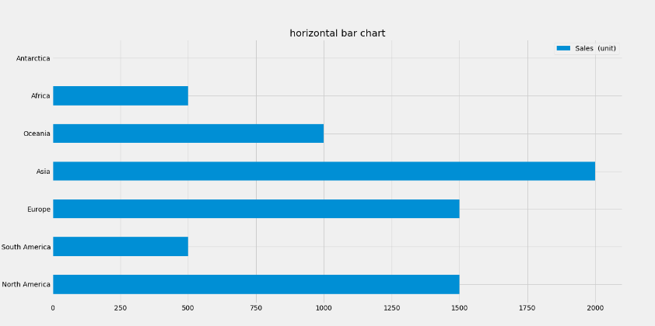
Nominal Data (Qualitative)
• Nominal means name and count
- Data are alphabetic or numerical in name
• They are categories without order or direction
• They are used to track people , object or event
Continent | Sales (unit)
North America | 1,500
South America | 500
Europe | 1,500
Asia | 2,000
Oceania | 1,000
Africa | 500
Antarctica | 1

Slide 23
Ordinal Data (Qualitative)
Ordinal means rank or order
Data place in order. They are ordered categories like ranking or scaling.
Has no absolute value
More precise comparison are not possible

Slide 24
Categorical Data (Qualitative)
◘ Nominal
Employee ID
Gender
Religion
Ethnicity
Pin codes
Place of birth
Aadhaar numbers
◘ Ordinal
Mutual fund risk ratings
Fortune 50 rankings
Movie ratings
While there is an order, difference between consecutive levels are not always equal.

Slide 25
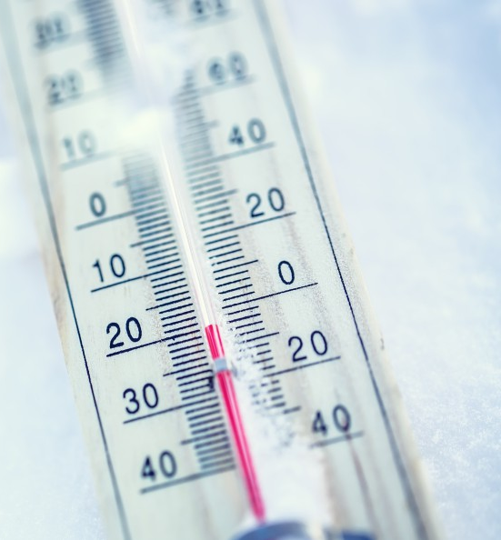
Quantitative Data - Interval
Data where ordering is clear and the difference in data values is meaningful.
Interval data, also called an integer, is defined as a data type which is measured along a scale, in which each point is placed at equal distance from one another.
However, there is no natural zero or origin.
Example: Year 1008 vs 2016 Temperature: 14C vs 28C

Slide 26
Quantitative Data - Ratio
Ratio level data is similar to Interval level data, with the key difference – there is a natural zero point.
Examples: Weights, Cost of things, Number of correct answers in a exam

Slide 27
Summary of Level of Data Measurement
◘ Nominal – Categories only
◘ Ordinal – Categories with some order
◘ Interval – Meaningful difference, but no zero point
◘ Ratio – Meaningful difference with a natural starting point.

Slide 28
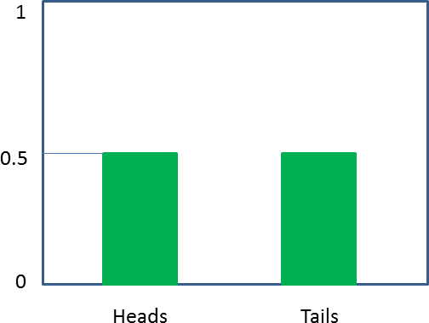
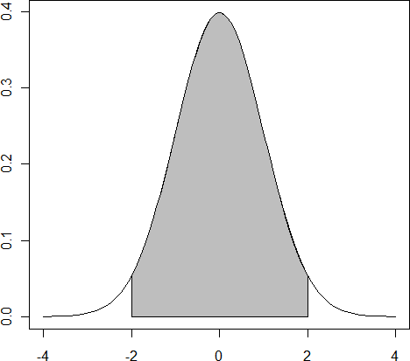
Discrete and Continuous
Countable Measurable

Slide 29
Discrete or Continuous
Statement | Discrete / Continuous
TIME between customer arrivals at retail outlet
Sampling the volume of liquid nitrogen in a storage tank
Sampling 100 voters in a exit poll and determining how many voted for the wining candidate
Length of newly designed automobiles
No. of customers arriving at a retail outlet during a five minute period.
No. of defects in a batch of 50 items
Continuous
Continuous
Discrete
Continuous
Discrete
Discrete

Slide 30
Describing Data through Statistics
Descriptive Statistics

Slide 31

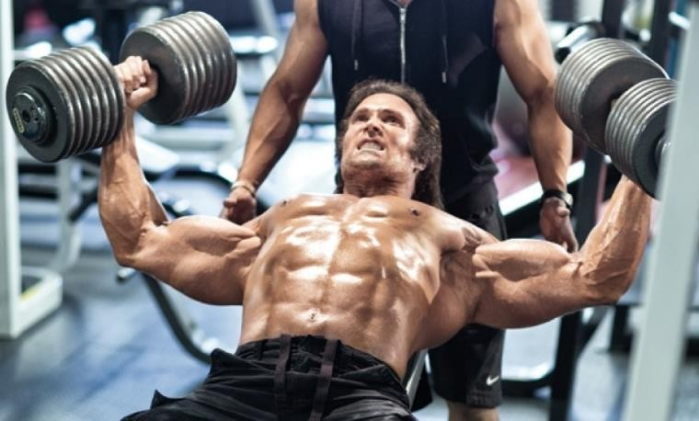
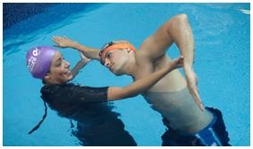
The Central Tendencies
Vijay Devarkonda want to join a health club in a activity that has others in the same age group as him. He is 22 years old. Mean ages for YOGA, POWER WORKOUT and SWIMMING classes are
15 years
20 years
17 years

Slide 32

The Central Tendencies
Yoga class composition
$$Mean, μ=\frac{∑x}{n}=$$
$$\frac{13 ∗ 1+15 ∗3+17 ∗2 }{1+3+2}$$
Age (years) | 13 | 15 | 17
Frequency, f | 1 | 3 | 2

Slide 33

The Central Tendencies
Power workout class composition
$$Mean, μ=\frac{∑x}{n}=$$
$$\frac{13 ∗4+15 ∗6+17 ∗3 +90 ∗1}{4+6+3+1}$$
Age (years) | 13 | 15 | 17 | 90
Frequency, f | 4 | 6 | 3 | 1

Slide 34


The Central Tendencies
Age (years) | 13 | 15 | 17 | 90
Frequency, f | 4 | 6 | 3 | 1
$$Outlier$$
$$μ=20$$

Slide 35
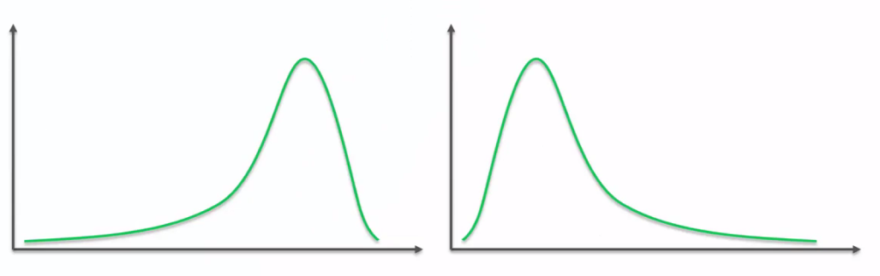
Left or – ve skew
Right or + ve skew

Slide 36
The Central Tendencies – Median
Data has outlier
Median - the mid-point
13, 13, 13, 13, 15, 15, 15, 15, 15, 15, 17, 17, 17, 90
Age (years) | 13 | 15 | 17 | 90
Frequency, f | 4 | 6 | 3 | 1

Slide 37

The Central Tendencies
Age (years) | 13 | 15 | 17 | 90
Frequency, f | 4 | 6 | 3 | 1
Median$=20$
$$μ=20$$

Slide 38
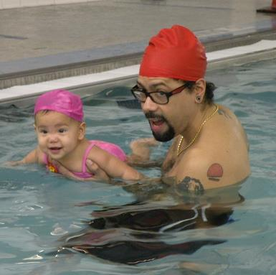
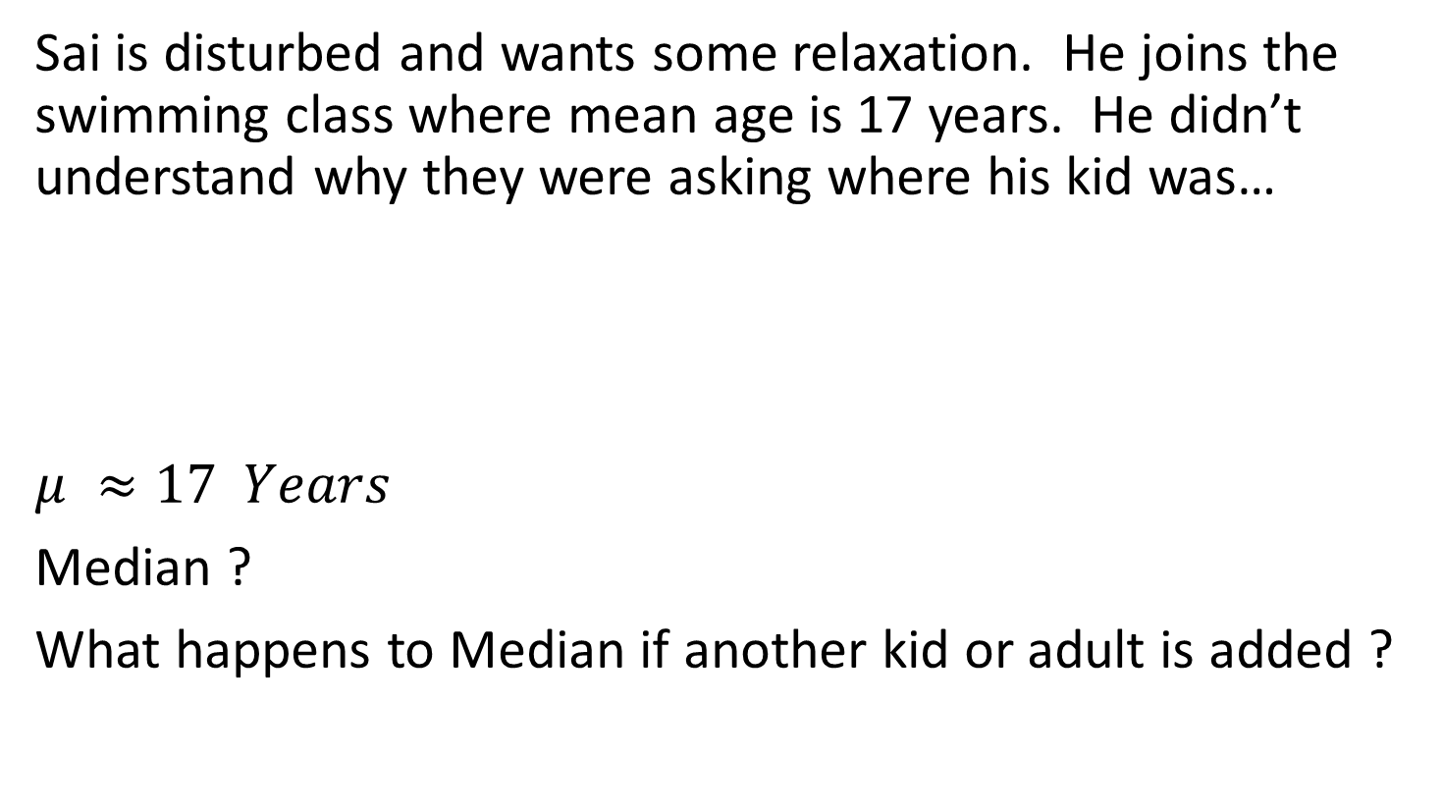
The Central Tendencies
Sai is disturbed and wants some relaxation. He joins the swimming class where mean age is 17 years. He didn’t understand why they were asking where his kid was…
$$μ ≈17 Years$$
Median ?
What happens to Median if another kid or adult is added ?
Age (Years) | 1 | 2 | 3 | 30 | 31 | 32 | 33
Frequency,f | 3 | 4 | 3 | 1 | 3 | 2 | 4

Slide 39
The Central Tendencies
What is the mode – the most frequently occurring data point ?
Age (Years) | 1 | 2 | 3 | 30 | 31 | 32 | 33
Frequency,f | 3 | 4 | 3 | 1 | 3 | 2 | 4

Slide 40
The Central Tendencies
Mean and Median need not be in the dataset but Mode has to be in it.
Mode is also the only central-tendency statistic that works with categorical data.

Slide 41



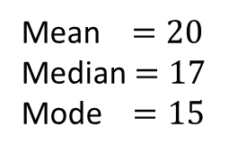
The Central Tendencies
Age (years) | 13 | 15 | 17 | 18 | 19 | 25 | 90
Frequency, f | 4 | 6 | 5 | 4 | 4 | 3 | 1
M$ode=15$
Mean $=20$
Median $=17$
Mode $=15$
Median $=17$
Mean $=20$

Slide 42
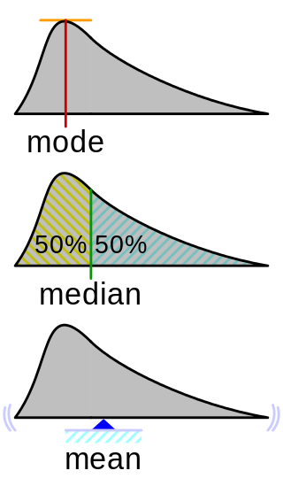
The Central Tendencies

Slide 43
The Central Tendencies
The management of Good Heart Inc. wants to give all its employees a raise. They are unable to decide if they should give a straight Rs. 2000 to everyone or to increase salaries by 10% across the board. The mean salary is Rs. 50,000, the median is Rs. 20,000 and the mode is Rs. 10,000.
How do these central tendencies change in both cases?

Slide 45
Measuring Variability and Spread
Range, Variance, Standard Deviation

Slide 46
Range to differentiate between dataset
It is quite often, the average only gives part of the picture.
Averages give us a way of determining where the centre of a set of data is, but they don’t tell us how the data varies.
“The range tells us over how many numbers the data extends, a bit like measuring its width.”

Slide 47
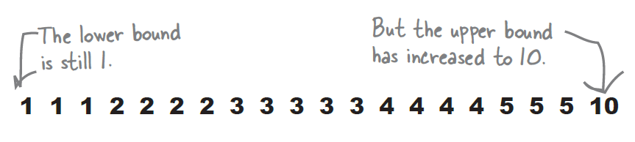
Range
The range is a way of measuring how spread out a set of values are. It’s given by Upper bound - Lower bound where the upper bound is the highest value, and the lower bound the lowest.
Range = upper bound - lower bound
= 10 -1
= 9
so, the range is 9

Slide 49
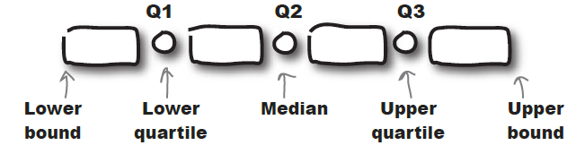
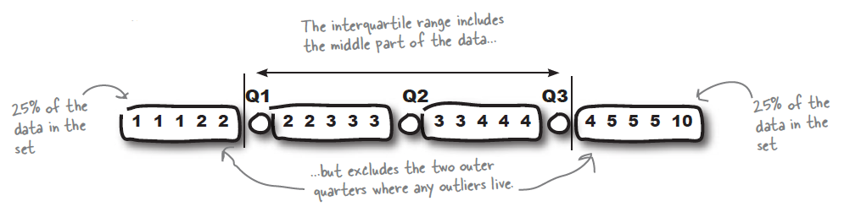
Quartiles will rescue the problem
Quartiles of a set of data is a very similar process to finding the median.

Slide 50
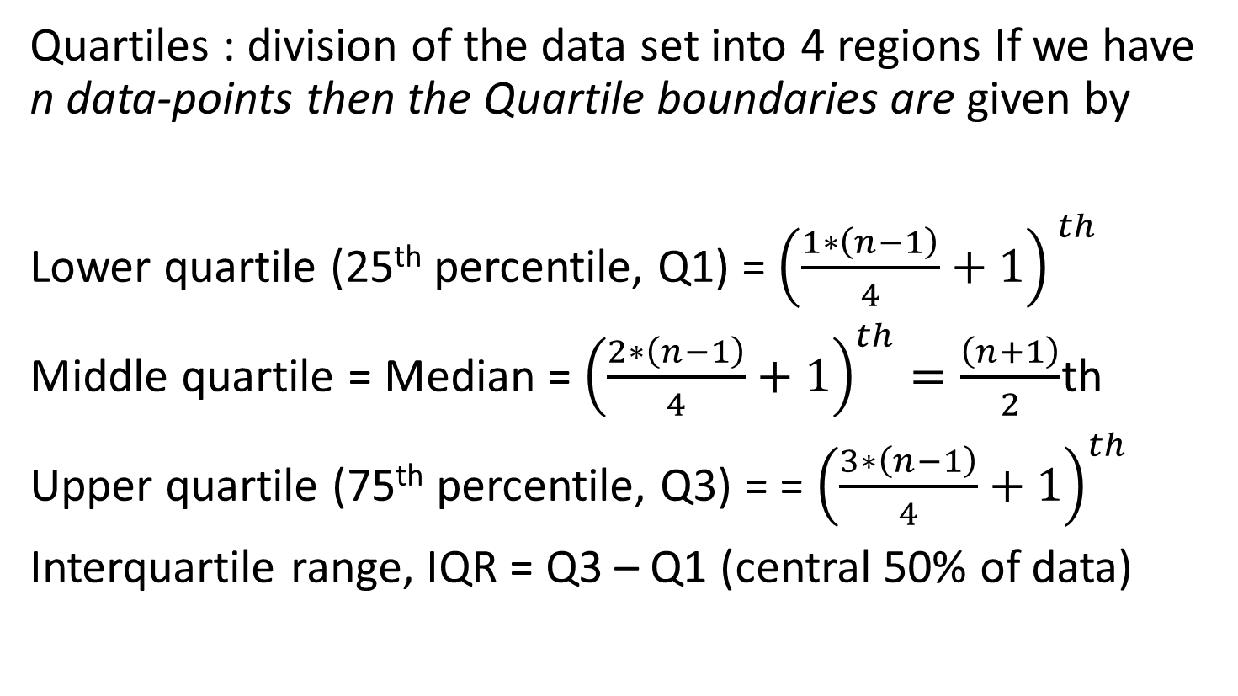
Quartiles
Quartiles : division of the data set into 4 regions If we have n data-points then the Quartile boundaries are given by
Lower quartile (25th percentile, Q1) = ${\left(\frac{1∗\left(n−1\right)}{4}+1\right)}^{ th}$
Middle quartile = Median = ${\left(\frac{2∗\left(n−1\right)}{4}+1\right)}^{th}=\frac{\left(n+1\right)}{2}$th
Upper quartile (75th percentile, Q3) = = ${\left(\frac{3∗\left(n−1\right)}{4}+1\right)}^{th}$
Interquartile range, IQR = Q3 – Q1 (central 50% of data)

Slide 51

Quartiles
Percentile: divide the dataset into 100 regions
$pth$ Percentile = $\left(\frac{p∗\left(n−1\right)}{100}+1\right)th$

Slide 52
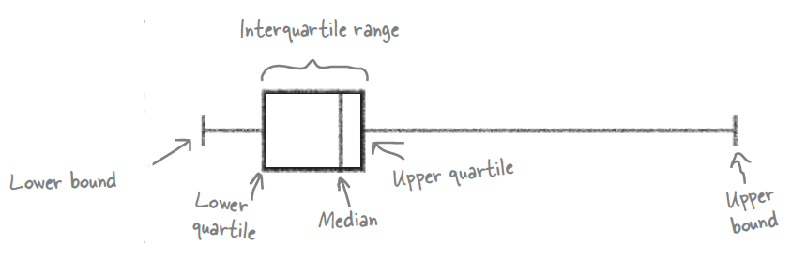
Box Plot → Quatiles

Slide 53
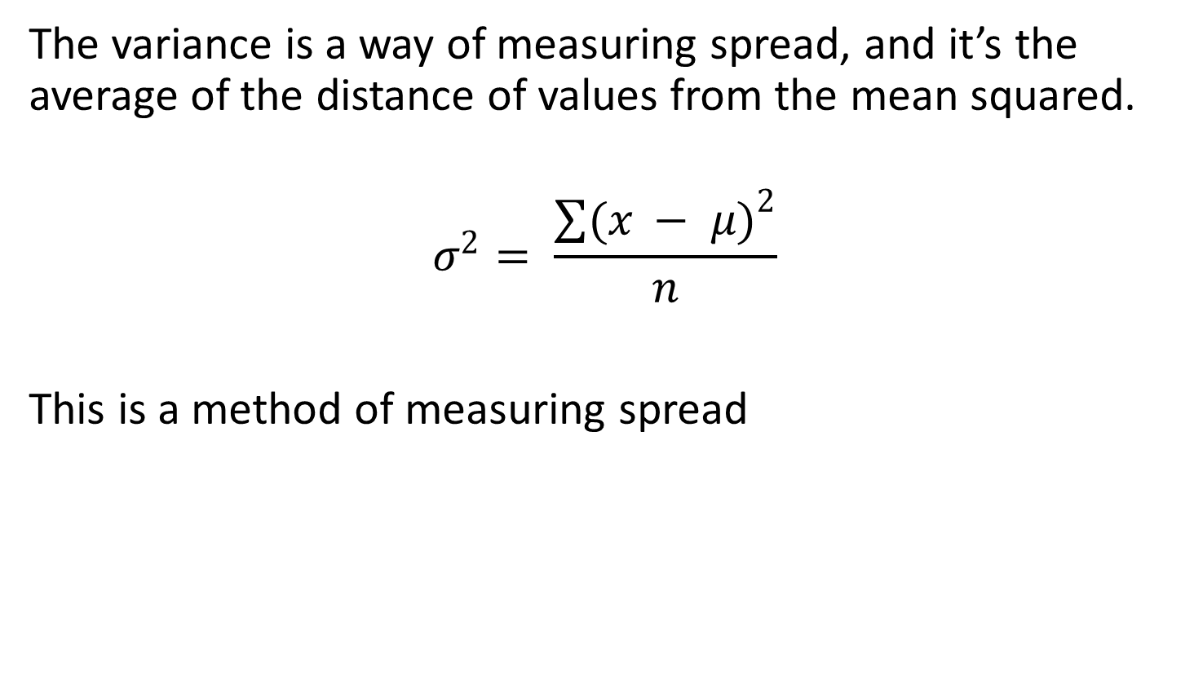
Variance
The variance is a way of measuring spread, and it’s the average of the distance of values from the mean squared.
$$σ^{2}= \frac{\sum{{(x − μ)}^{2}}}{n}$$
This is a method of measuring spread

Slide 54
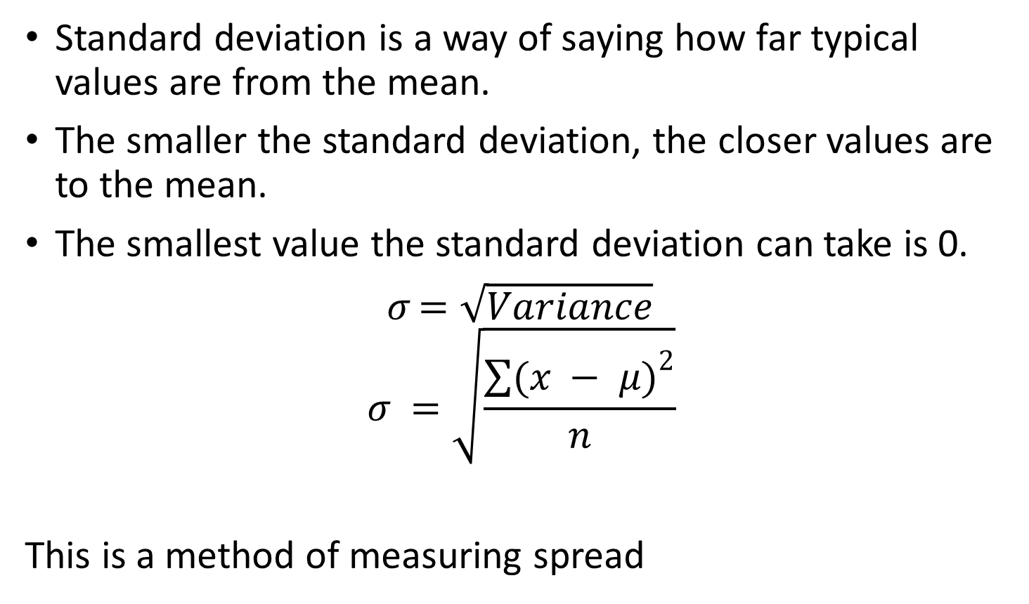
Standard deviation
Standard deviation is a way of saying how far typical values are from the mean.
The smaller the standard deviation, the closer values are to the mean.
The smallest value the standard deviation can take is 0.
${ σ}^{ }=\sqrt{Variance}$
$$σ^{ }=\sqrt{\frac{\sum{{(x − μ)}^{2}}}{n}}$$
This is a method of measuring spread

Slide 55
Value | Mean | value- Mean | Z | Outlier ?
1 | 3.26 | -2.26 | -1.1037 | Not outlier
1 | 3.26 | -2.26 | -1.1037 | Not outlier
1 | 3.26 | -2.26 | -1.1037 | Not outlier
2 | 3.26 | -1.26 | -0.6160 | Not outlier
2 | 3.26 | -1.26 | -0.6160 | Not outlier
2 | 3.26 | -1.26 | -0.6160 | Not outlier
2 | 3.26 | -1.26 | -0.6160 | Not outlier
3 | 3.26 | -0.26 | -0.6160 | Not outlier
3 | 3.26 | -0.26 | -0.1283 | Not outlier
3 | 3.26 | -0.26 | -0.1283 | Not outlier
3 | 3.26 | -0.26 | -0.1283 | Not outlier
3 | 3.26 | -0.26 | -0.1283 | Not outlier
4 | 3.26 | 1.74 | 0.3593 | Not outlier
4 | 3.26 | 1.74 | 0.3593 | Not outlier
4 | 3.26 | 1.74 | 0.3593 | Not outlier
4 | 3.26 | 1.74 | 0.3593 | Not outlier
5 | 3.26 | 2.74 | 0.8470 | Not outlier
5 | 3.26 | 2.74 | 0.8470 | Not outlier
10 | 3.26 | 7.74 | 3.28 | outlier

Slide 56
Action Check`
Basketball coach Statson is in a dilemma choosing between 3 players all having the same average scores.
Points Scored per game | 7 | 8 | 9 | 10 | 11 | 12 | 13
Frequeny,f | 1 | 1 | 2 | 2 | 2 | 1 | 1
Points Scored per game | 7 | 9 | 10 | 11 | 13
Frequency, f | 1 | 2 | 4 | 2 | 1
Points Scored per game | 3 | 6 | 7 | 10 | 11 | 13 | 30
Frequency, f | 2 | 1 | 2 | 3 | 1 | 1 | 1

Slide 57
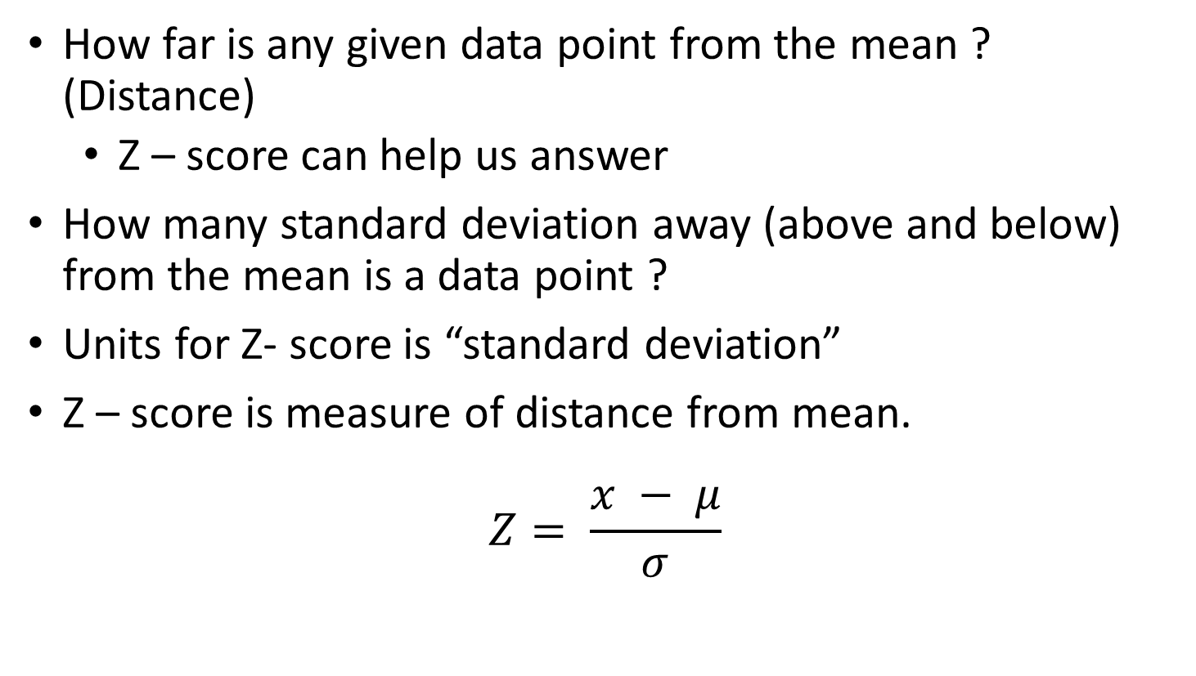
Z - Score
How far is any given data point from the mean ? (Distance)
Z – score can help us answer
How many standard deviation away (above and below) from the mean is a data point ?
Units for Z- score is “standard deviation”
Z – score is measure of distance from mean.
$$Z= \frac{x − μ}{σ}$$

